Slide 1
Compact Routing Theory and Practice
Can we route within Internet with tables of 8 entries ?
Cyril Gavoille, Christian Glacet, Nicolas Hanusse, David Ilcinkas
Bordeaux U., LaBRI

Slide 2
Routing for n destinations
u
2
1
w
ID | port
.. | ..
v | 2
.. | ..
v
n = # entries (stored)
Notes:
Toute source vers toute dest.
Utilise des tables de routage pour décider.
Ici c’est du plus court chemin.

Slide 3
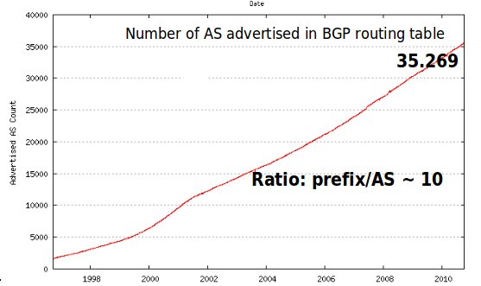
Motivation
Failures/Maintenance cost/time ↑
Routing among the 35 000 Autonomous Systems: BGP !
Main observations:
Based on shortest paths routing: > n entries per routing table
Network size increases
Highly Dynamic: from 1 to 1000 path change per update
Engineering techniques progress << Routing Tables increase

Slide 4
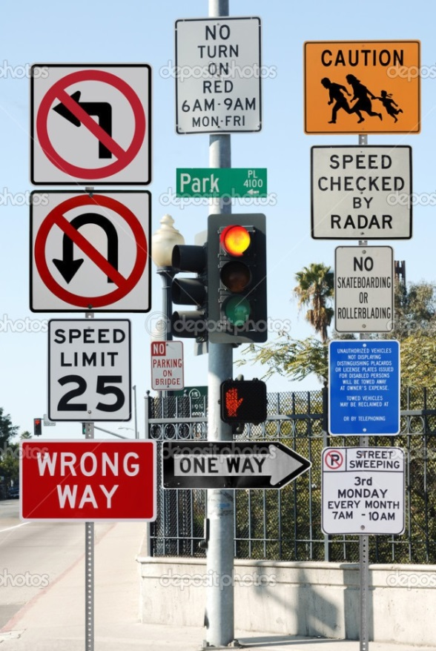
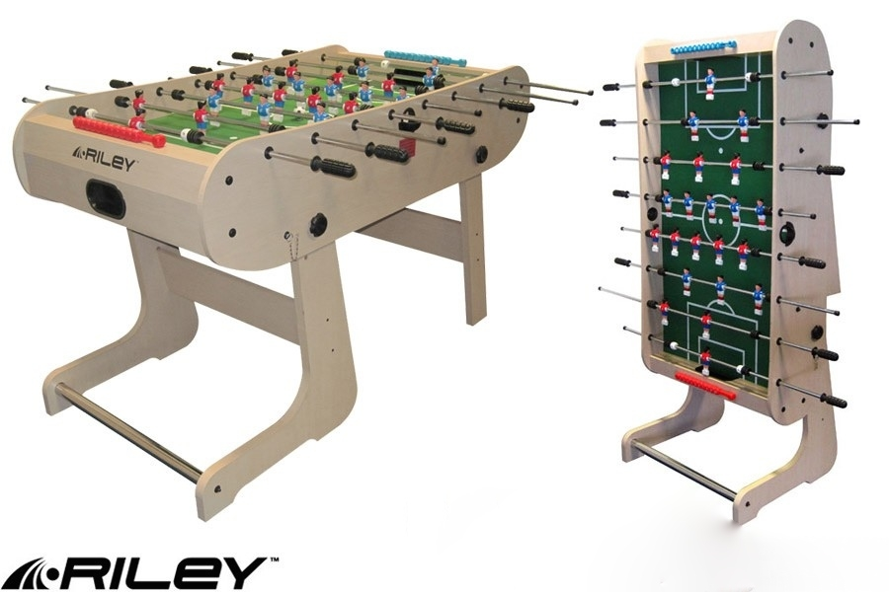
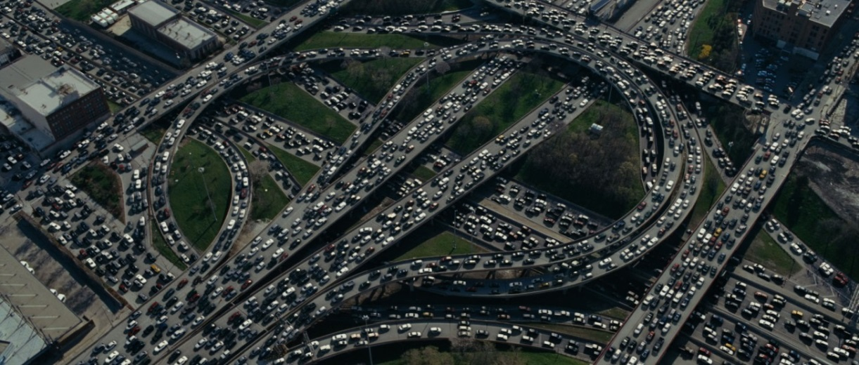
Not in this talk
Network Policy
Contention
Faults/Cheating

Slide 5
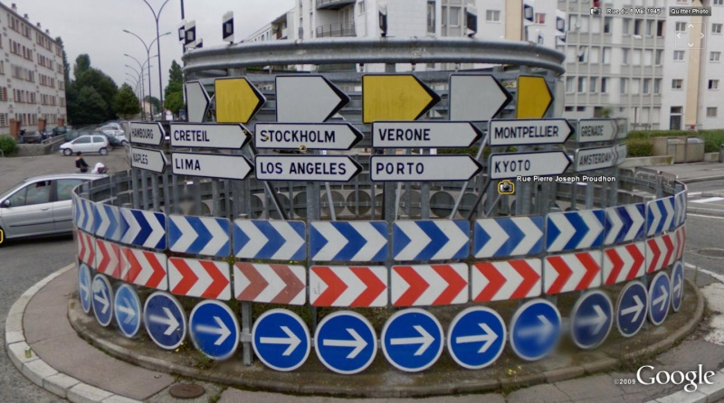
How can we PROVIDE A LIGHTER ROUTING SCHEME WITH SOME GARANTEE ?

Slide 6
Accept to make bounded detour (STRETCH)
u
w
2
5
Length of a path (u,w)
5
Stretch of a path (u,v)=
distance(u,w)
=
2

Slide 7
Our model
A weighted graph G of weights in [1,W]
n nodes, m edges
Hop distance hd(u,v) = minimum number of hops of shortest paths between u and v
Hop diameter D = max hd(u,v)
Two distributed models:
LOCAL: delay = 1
ASYNC: delay < 1
Name-independant Schemes: relabeling nodes is not allowed

Slide 8
Routing & Performance
Latency of a routing
Time to traverse links (stretch)
Lookup Time in routing tables (size of routing tables/Memory)
Maintenance cost: #messages to update tables
Maintenance time: convergence time
Stretch = Path length of the routing /distance

Slide 9
What can be achieved ?
Lower bounds !
Stretch = 1 → Ω(n) entries per node can be required [G.-Perennes 1996]
Stretch < 5 → Ω(n^{1/2}) entries per node can be required [Abraham-Gavoille-Malkhi 2006]
Upper bounds !
Stretch 1, O(n² log n) messages but time Θ(D log n) [Afek, Ricklin 1993]
Stretch 12k+3, O(k³n^{1/k}) entries on average for unweighted graphs [Peleg – Upfal 1989]
Stretch 2^{k}-1 and O(kn^{1/k}) entries on average [Awerbuch et al. 1990]
Stretch k² and O(n^{2/k}) entries per node [Arias et al. 2006]
Stretch O(k) and O(n^{1/k}) entries per node [Abraham, Gavoille, Malkhi 2006]
Distance/path vector has conv. time D and Ω(mn) messages
Compact routing schemes: centralized or synchronous !!

Slide 10
What can be achieved ?
Lower bounds !
Stretch = 1 → Ω(n) entries per node can be required [G.-Perennes 1996]
Stretch < 5 → Ω(n^{1/2}) entries per node can be required [Abraham-Gavoille-Malkhi 2006]
Upper bounds !
Stretch 1, O(n² log n) messages but time Θ(D log n) [Afek, Ricklin 1993]
Stretch 12k+3, O(k³n^{1/k}) entries on average for unweighted graphs [Peleg – Upfal 1989]
Stretch 2^{k}-1 and O(kn^{1/k}) entries on average [Awerbuch et al. 1990]
Stretch k² and O(n^{2/k}) entries per node [Arias et al. 2006]
Stretch 3 and O(n^{1/2}) entries per node [Abraham, Gavoille, Malkhi, … 2008]
Distance/path vector has conv. time D and Ω(mn) messages
Compact routing schemes: centralized or synchronous !!
AGMaNT

Slide 11
Our goal: How to build tables from scratch ?
Universal:
→ Any topology, asynchronous network
Fast distributed computation:
→ Convergence time O(D).
Light consumption:
→ Memory: O(n^{1/k})
→ Messages: o(n² log n) for a synchronous version
Guarantee on routing:
→ Stretch O(k)

Slide 12
A first distributed compact routing scheme DCR (DISC’2013)
Asynchronous Distributed name-independant Compact Routing schemes (AGMANT based)
Stretch 7
Convergence Time O(D)
Memory O(n^{1/2})
In a synchronous scenario
O(ξ (m n^{1/2}) + n^{3/2} min(D, n^{1/2})) messages
ξ=1+D(1-1/W) for weighted graphs
ξ=1 for unweighted graphs

Slide 13
Our results for « realistic graphs » in a synchronous scenario
Schemes | Stretch | Memory | #Messages | Time
Dist/Path Vector | 1 | Ω(n) | O(n²) | O(D)
DCR 7 | 7 | O(n^{1/2}) | O(n^{3/2}) | O(D) | DISC
DCR 5 | 5 | O(n^{1/2}) | O(n^{3/2}) | O(D) | DISC ext.
Memory LB | < 2k+1 | Ω((n log n)^{1/k}) | Any | Any | Abraham-Gavoille-Malkhi 2006
Message LB | 1 | Any | Ω(n²) | o(n)
Time LB | < n/3D | Any | Any | Ω(D)
« realistic graphs »: O(n log n) edges, hop-diameter O(log n) and unweighted.

Slide 14
Our results for « realistic graphs » in a synchronous scenario
Schemes | Stretch | Memory | #Messages | Time
Dist/Path Vector | 1 | Ω(n) | O(n²) | O(D)
AGMANT 7 | 7 | O(n^{1/2}) | O(n^{3/2}) | O(D)
AGMANT 5 | 5 | O(n^{1/2}) | O(n^{1/2}) | O(D)
Memory LB | < 2k+1 | Ω((n log n)^{1/k}) | Any | Any | Abraham-Gavoille-Malkhi 2006
Message LB | 1 | Any | Ω(n²) | o(n)
Time LB | < n/3D | Any | Any | Ω(D)
« realistic graphs »: O(n log n) edges, hop-diameter O(log n) and unweighted.

Slide 15
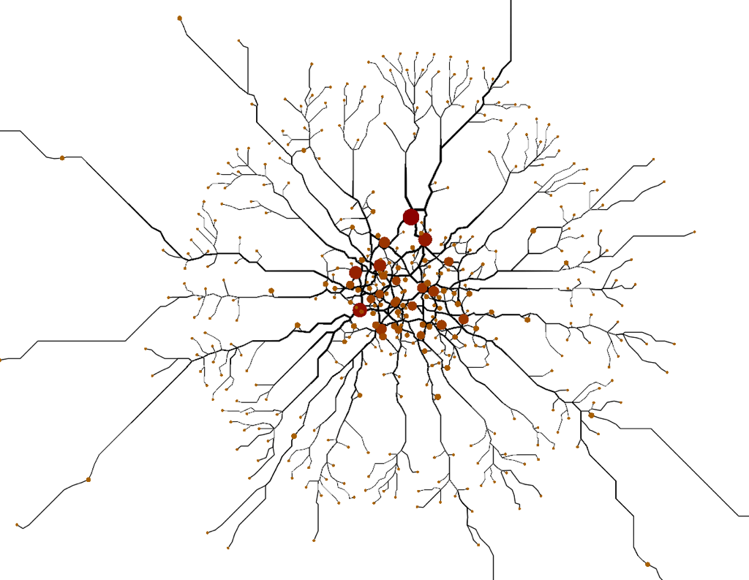
Real-life and scale-free graphs
Small average degree
Small diameter
Degree distribution follows a power law.
For instance, CAIDA’04 n = 17 300
m = 35 500
D = 10

Slide 16
CAN WE DESIGN A MORE EFFICIENT ROUTING SCHEME FOR REAL-LIFE NETWORK ?

Slide 17
Scale-free specialized compact routing schemes
Sommer et al, DISC 2009 & TALG 2012:
Very small average memory O($n^{1/3}$), Stretch 5 for Random Power Law Graphs BUT in labeled schemes and a centralized algorithm.
Tang et al, Computer Communications 2012 (HDLR):
Average memory = O($n^{1/2}$), Stretch O(1) for Random Power Law Graphs in independant schemes and centralized algorithm
Small improvment w.r.t. AGMaNT in practice

Slide 18
HDLBR specialized to power law networks
H(v)
L: nodes of highest degree
L(u)
L(v)
Inverse ball of L(v)
u
v
Landmarks L: $n^{1/2}$ nodes and shortest paths trees
vicinity balls B: closest nodes until reaching Landmarks
Routing from u to v: if v not in B(u), reach landmark H(v)
random hash function h(id_{v}) in [1, $n^{1/2}$]
H(v): landmark in charge the hash value h(v) … knows L(v) …

Slide 19
Our proposition: Cluster specialized to power law networks and minimizing memory.
H(v)
L(u)
L(v)
leader
u
v
Leader: node of highest degree
Landmarks L: closest nodes of leader
Only 1 shortest path tree rooted in the leader !!!

Slide 20
EXPERIMENTS
Vizroute: a high-level routing simulator

Slide 21
Communication cost
A real advantage of compact routing schemes w.r.t. Path-Vector (BGP)
CLUSTER wins if high degree nodes are very central.

Slide 22
Average Stretch
Between 1.5 and 1.7 for CAIDA

Slide 23
Memory (average #entries per node)
Advantages of the dedicated algorithms for CAIDA (cluster: 8 entries)

Slide 24
WHY CLUSTER IS SO EFFICIENT ?
Work in Progress

Slide 25
A random power law model RPLG
Fixed/expected Degree Random Graph [Chung-Lu 2002]
Nodes have weights: ${wi=\left(\frac{n}{i}\right)}^{\frac{1}{t−1}}$
Prob( (i,j) is an edge) = $wi wj$Z with Z=$\frac{1}{\sum_{i}{w_{i}}}$
If 2 ≤ t ≤ 3:
Distance between High degree nodes (is constant
Average distance = Θ (loglog n)
Diameter = Θ(log n)
Degree distribution follows a power law.

Slide 26
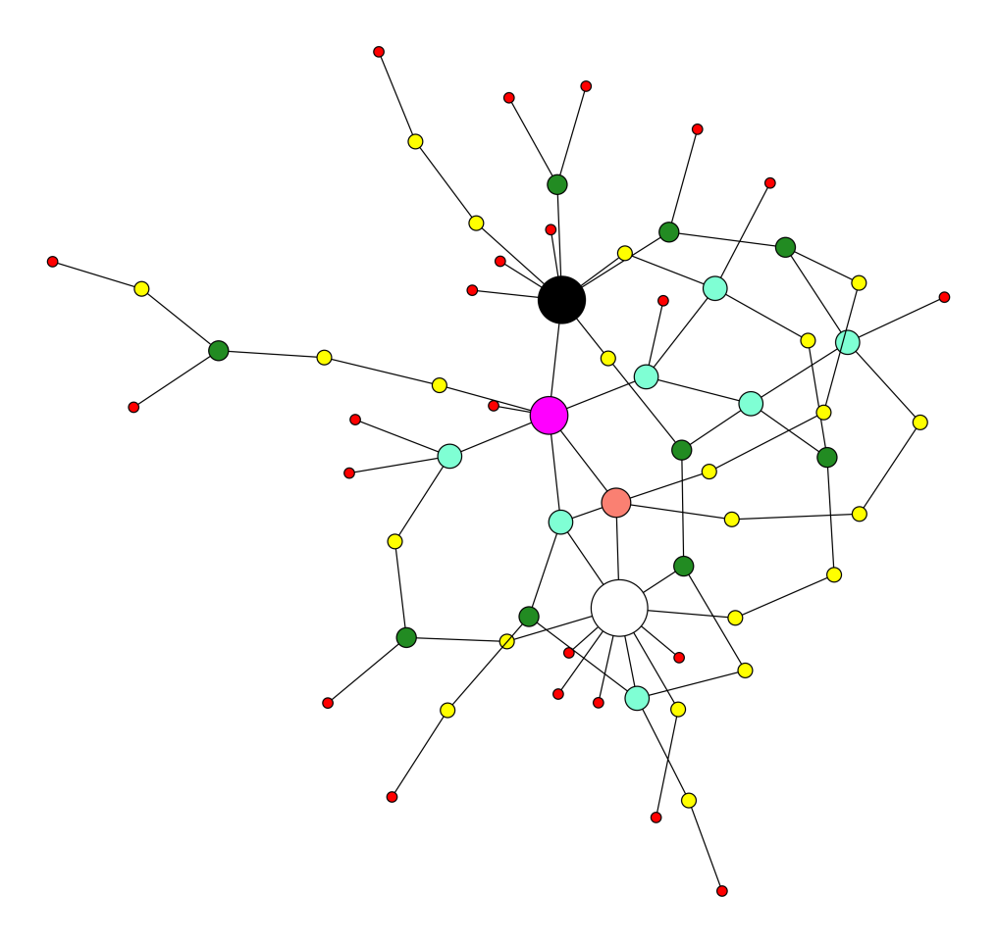
Examples of RPLG(n,t) graphs
t=2.1 (max degree high) t=3 (max degree small)

Slide 27
Our contribution
CLUSTER: take the $n^{1/2}$ closest nodes of the leader
CLUSTER-light: remove landmarks that are not neighbors of the leader + Add neighbors for nodes linked to landmarks.
Theorem: For any graph sampled from RPLG(n,t), t in (2,3) , w.h.p. CLUSTERs have the following performances:
Max Memory Size O($n^{1/2}$)
Avg Memory Size O($n^{c}$) with c=$\frac{t−2}{2(t−1)}$ for t ≤ 5/2 and c=$\frac{t^{2}−4t+4}{t−1}$ otherwise
Stretch 7 for CLUSTER and 5 for CLUSTER-light
$\lim_{n→∞}{\text{(}\text{Avg} \text{Stretch}})=1$

Slide 28
Examples
 | RPLG(n,t) for t=2.1 |  |  | BC graphs (other power law model) for n=10000
 | Stretch | Avg Memory | Max Memory | Stretch | Avg Memory | Max Memory
AGMaNT | 3 | $$\sqrt{n}$$ | $$\sqrt{n}$$ | 1.56 | 396 | 1143
AGMaNT /DCR | 5 | $$\sqrt{n}$$ | $$\sqrt{n}$$ | 1.63 | 396 | 1143
HDBLR | > 5 | $$\sqrt{n}$$ | $$n$$ | 1.24 | 404 | 1877
Cluster Cluster-l | 7 5 | $$n^{1/22}$$ | $$\sqrt{n}$$ | 1.92 | 12 | 246
Sommer | 5 | $$n^{1/12}$$ | $$n^{1/12}$$ | 1.3 | 55 | ?
Sommer/AGMaNT are centralized and Sommer holds for the labeled model.
$n^{1/12}$ obtained assuming the knowledge of t.
L=$\sqrt{n}$ for BC graphs

Slide 29
Key points (Memory) for RPLG
Radius of landmarks is 1 with high probability (max deg ${>n}^{1/2}$ )
Compute W(Landmarks)
Connection between disjoint sets:
S,T two disjoint subsets such that W_{S} W_{T} > f / Z
Pr( d(S,T) > 1 ) ≤ exp(-f)
$\sqrt{n}$closest nodes of the highest degree node is a heavy set
Vicinity balls do not have to be heavy (< n^1/2)
Vicinity balls do not grows too fast: b(r+1) < 8 b(r) for b > 192 log(n)
W
S

Slide 30
Stretch for RPLG
H(v)
u
v
Detour ≤ 2(d+2)

Slide 31
Example for t=3

Slide 32
Pour en savoir plus (parution en 2022)
Routing with 0,793 loglog n bits/node
Cyril Gavoille
Expert en limitation de dépassement de bits dans les strings

